Slide 1
Data and Computer Communication
Module 5
Error Detection, Correction, and Switching
Course Code: CXT 416
Dept. of Computer Science & Engineering

Slide 2
Table of Contents
1. Digital Data Communication Techniques
- Asynchronous Transmission
- Synchronous Transmission
2. Error Detection
- Types of Errors
- Parity Check (1D & 2D)
- Cyclic Redundancy Check (CRC)
- CRC Architecture & Shift Register
3. Error Correction
- Hamming Distance
- Hamming Code (7-bit Example)
4. Switching Techniques
- Circuit Switching
- Packet Switching (Datagram & Virtual Circuit)
- Message Switching

Slide 3
1. Digital Data Communication Techniques

Slide 4
Asynchronous Transmission
Character-Based Transmission
Architecture & Flow:
• In asynchronous transmission, data is sent one character (usually 8 bits) at a time.
• Synchronization is maintained only within each character, not the whole stream.
• Format: [Start Bit (0)] + [Data Bits (8)] + [Stop Bit (1)]
Characteristics:
• Simple and cheap implementation.
• High overhead (2-3 extra bits per character).
• Used in low-speed communication (e.g., Keyboards).

Slide 5
Synchronous Transmission
Block-Based Transmission
Architecture & Flow:
• Data is sent as a continuous stream of bits, grouped into large frames or blocks.
• Requires a common clock line or embedded timing signal.
• No gaps between characters.
Frame Format:
[Preamble] [Control Fields] [Data Block] [Error Check] [Postamble]
• Efficient for large data transfers (less overhead).

Slide 6
Asynchronous and Synchronous Transmission
Timing problems require a mechanism to synchronize the transmitter and receiver
Two solutions
Asynchronous
Synchronous

Slide 7
Asynchronous
Data transmitted on character at a time
5 to 8 bits
Timing only needs maintaining within each character
Resynchronize with each character

Slide 8
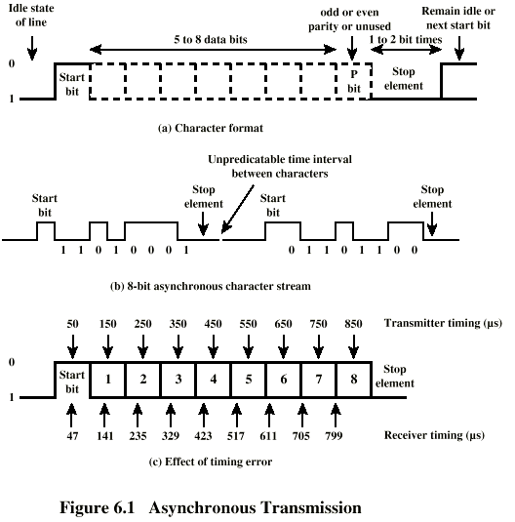
Asynchronous (diagram)

Slide 9
Asynchronous - Behavior
In a steady stream, interval between characters is uniform (length of stop element)
In idle state, receiver looks for transition 1 to 0
Then samples next seven intervals (char length)
Then looks for next 1 to 0 for next char
Simple
Cheap
Overhead of 2 or 3 bits per char (~20%)
Good for data with large gaps (keyboard)

Slide 10
Synchronous - Bit Level
Block of data transmitted without start or stop bits
Clocks must be synchronized
Can use separate clock line
Good over short distances
Subject to impairments
Embed clock signal in data
Manchester encoding
Carrier frequency (analog)

Slide 11
Synchronous - Block Level
Need to indicate start and end of block
Use preamble and postamble
e.g. series of SYN (hex 16) characters
e.g. block of 11111111 patterns ending in 11111110
More efficient (lower overhead) than async

Slide 12
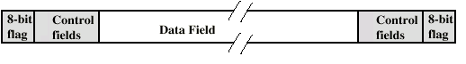
Synchronous (diagram)

Slide 13
2. Error Detection

Slide 14
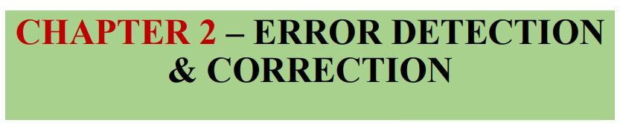

Slide 15
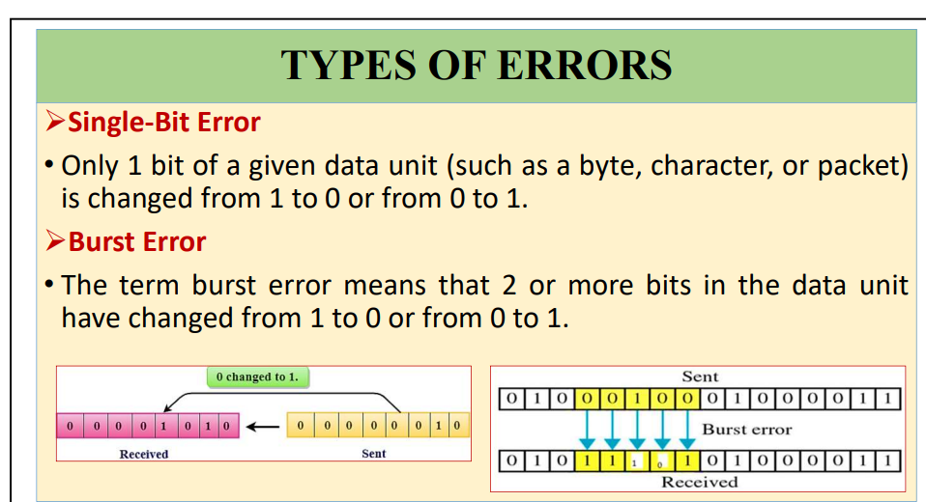

Slide 16
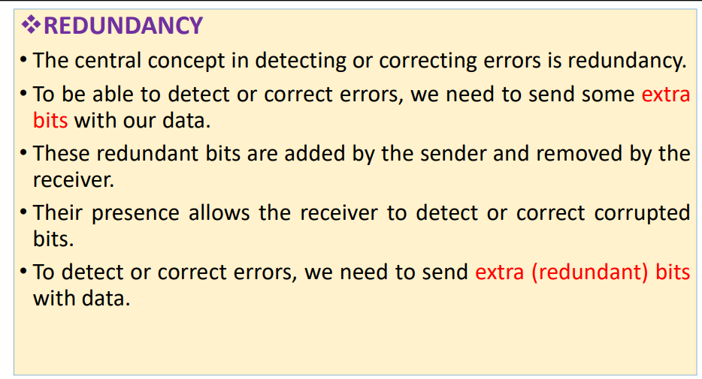

Slide 17
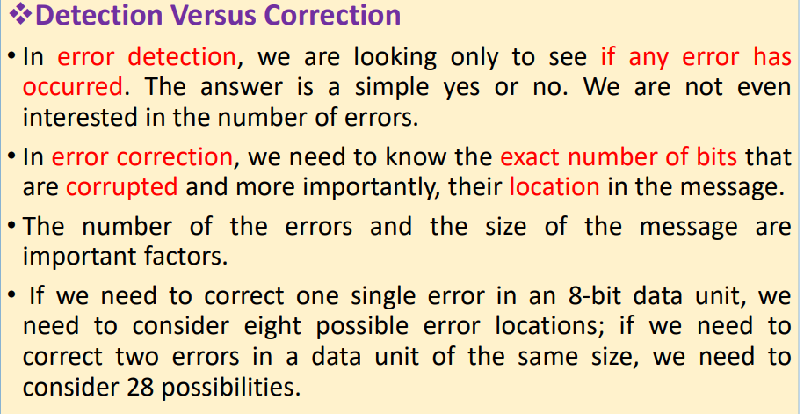

Slide 18
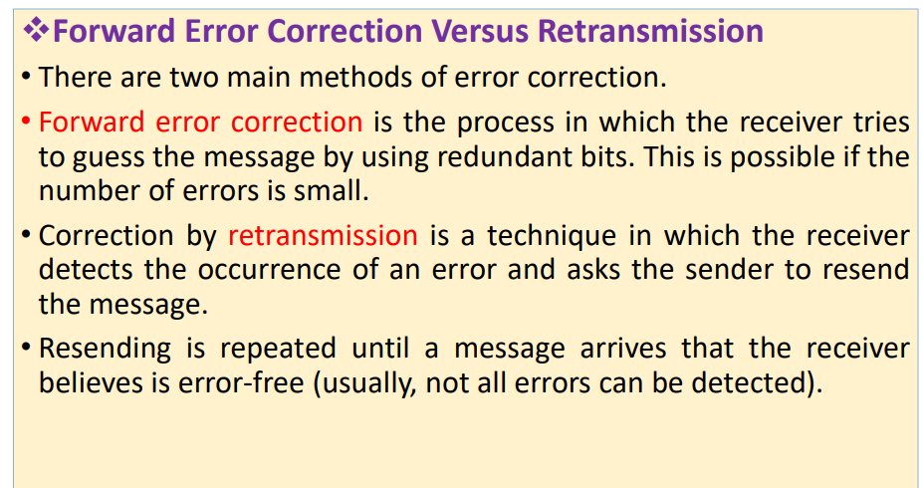

Slide 19
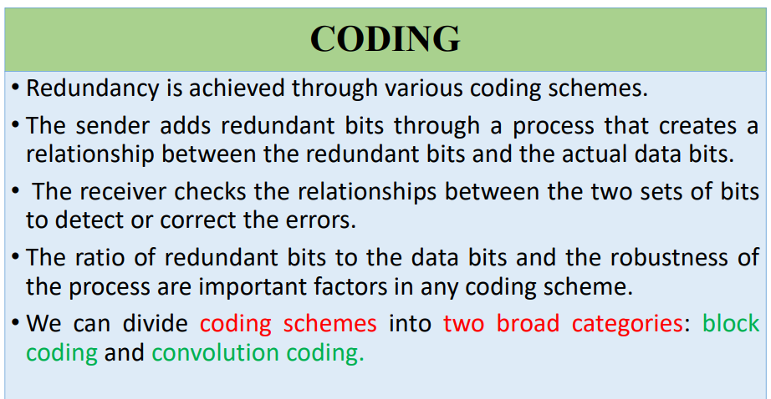

Slide 20
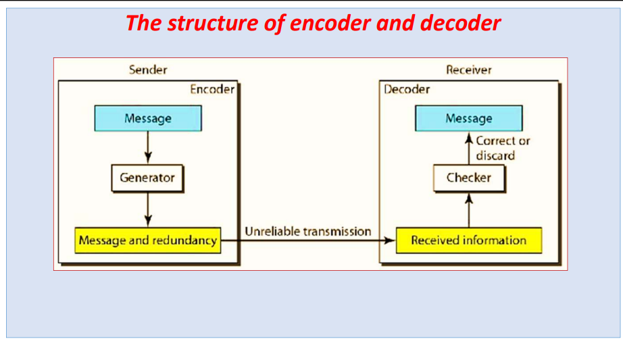

Slide 21
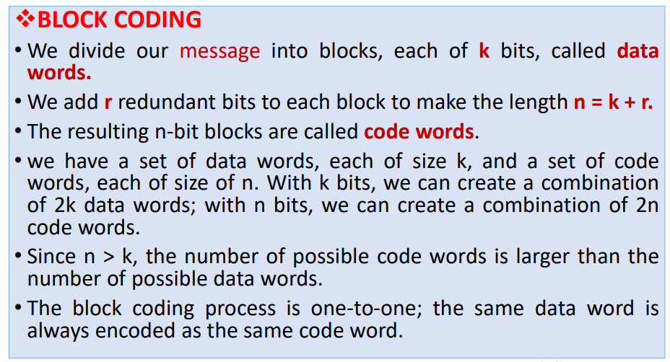

Slide 22
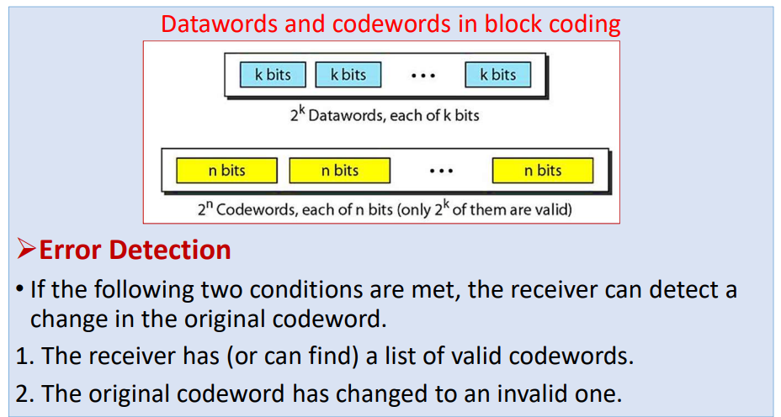

Slide 23
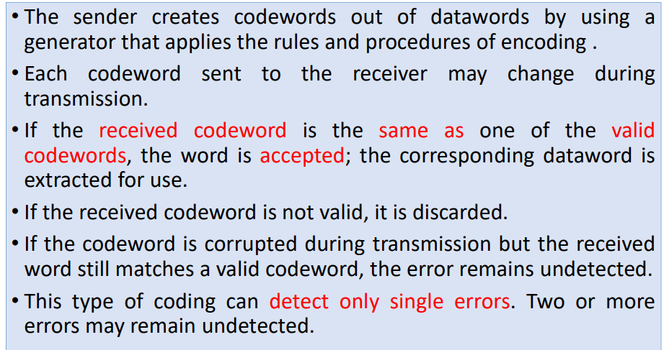

Slide 24
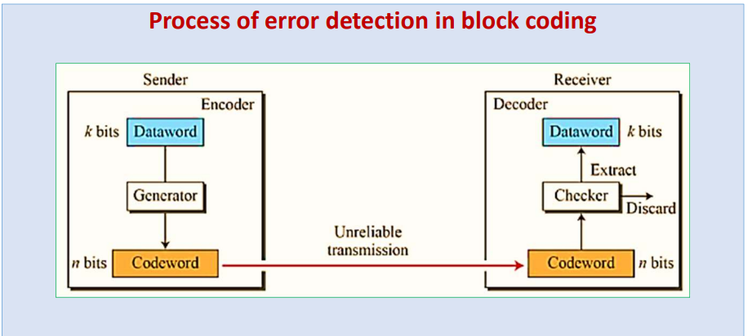

Slide 25
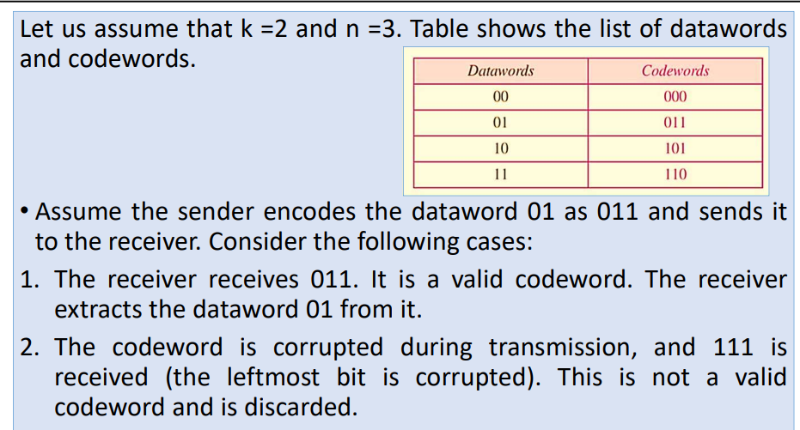

Slide 26
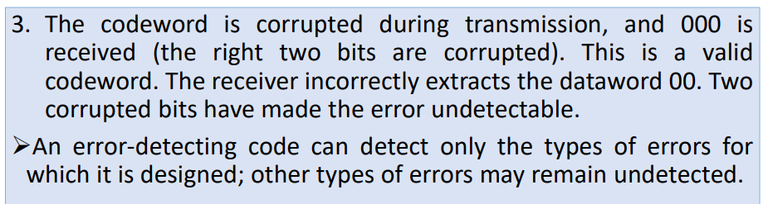

Slide 27
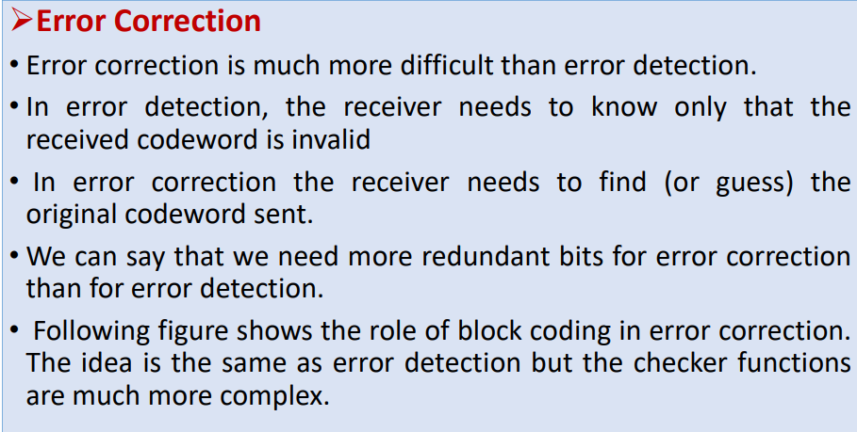

Slide 28
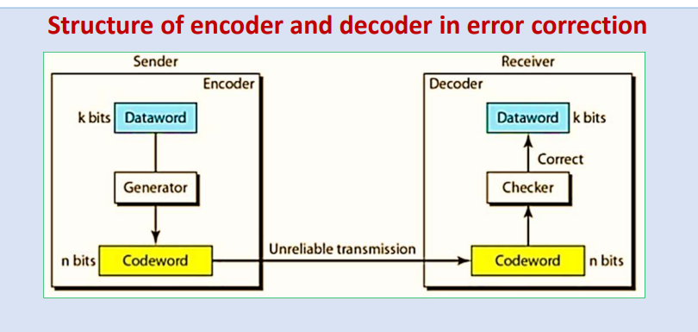

Slide 29
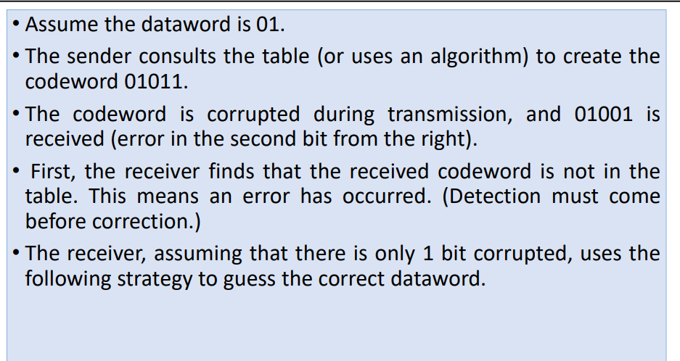

Slide 30
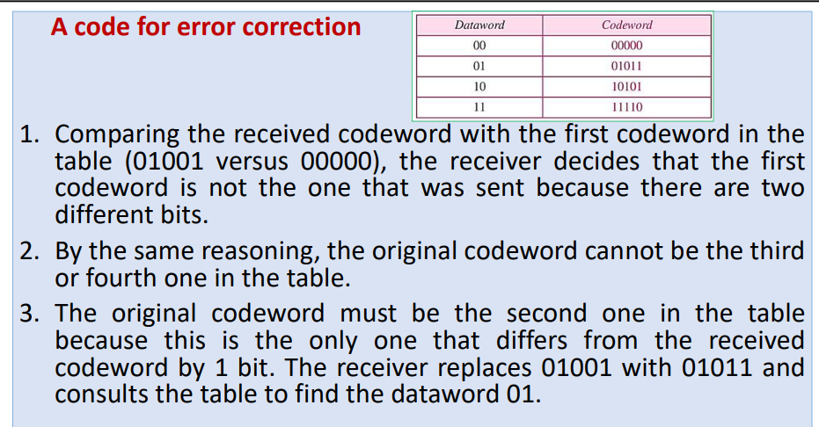

Slide 31
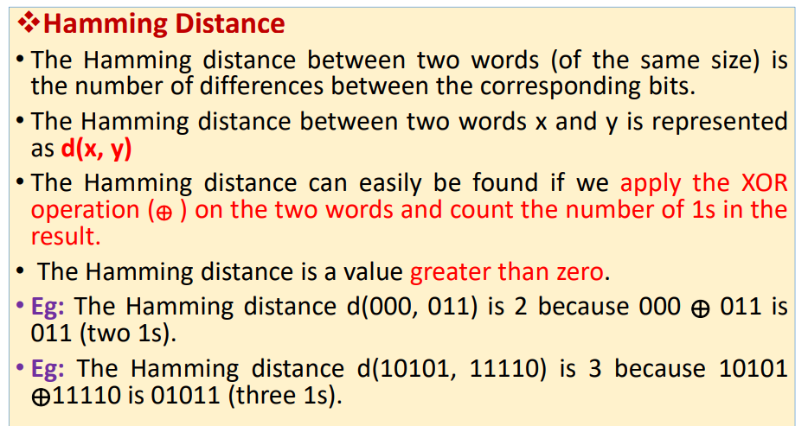

Slide 32
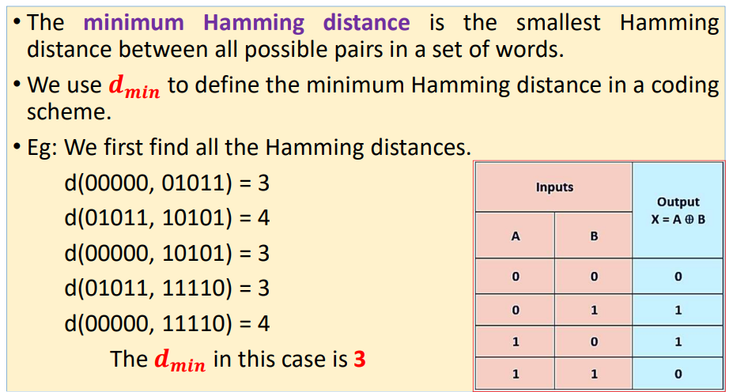

Slide 33
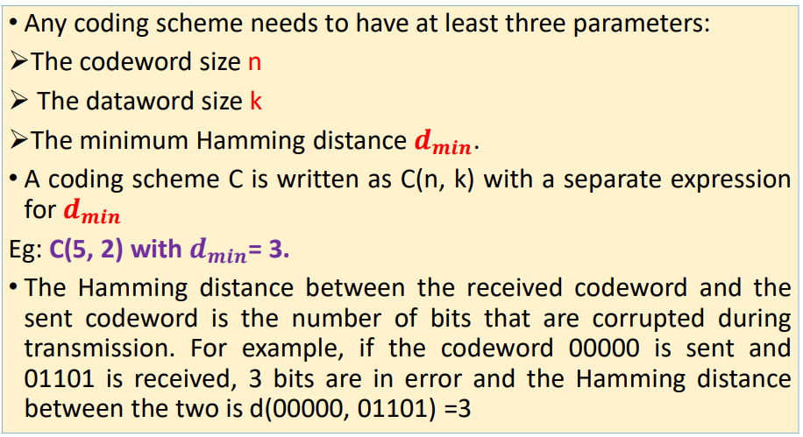

Slide 34
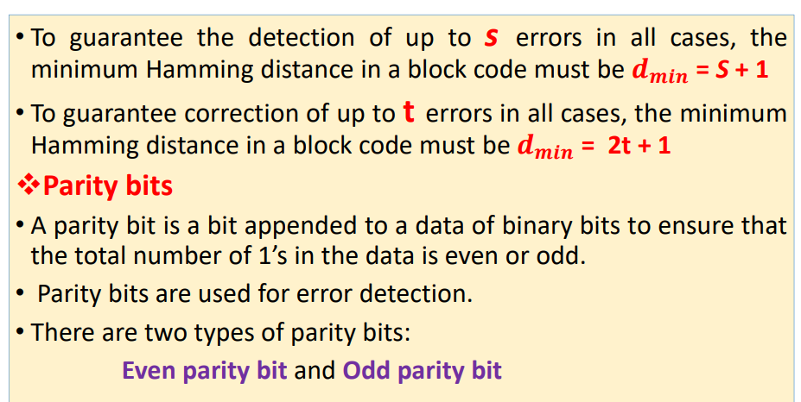

Slide 35
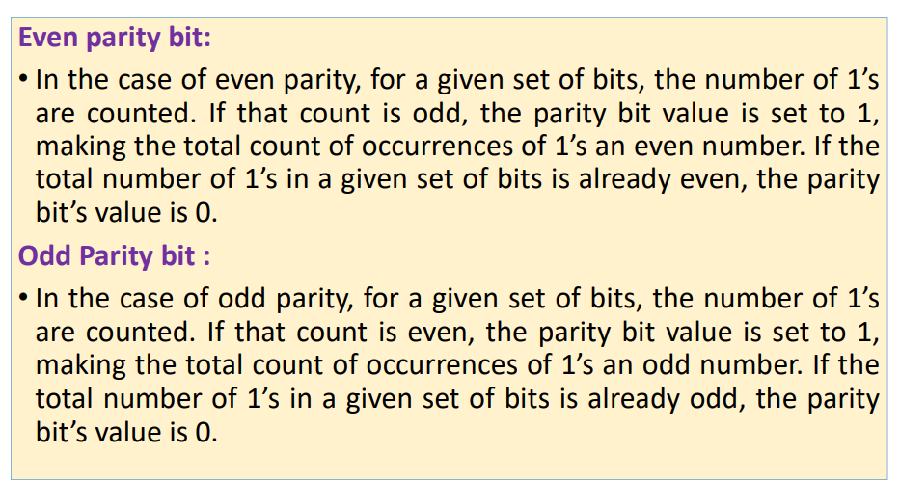

Slide 36
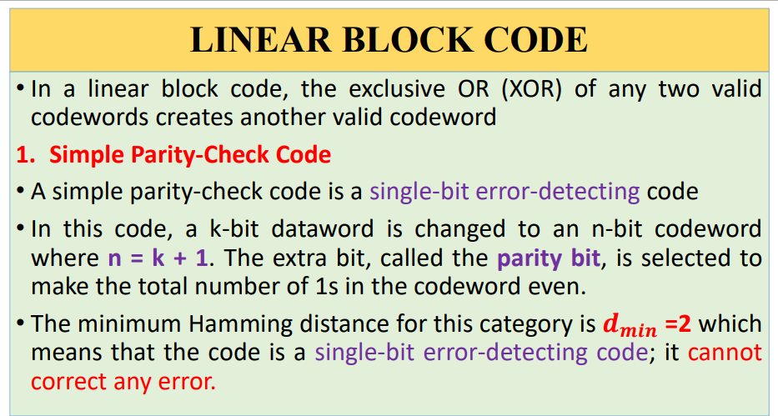

Slide 37
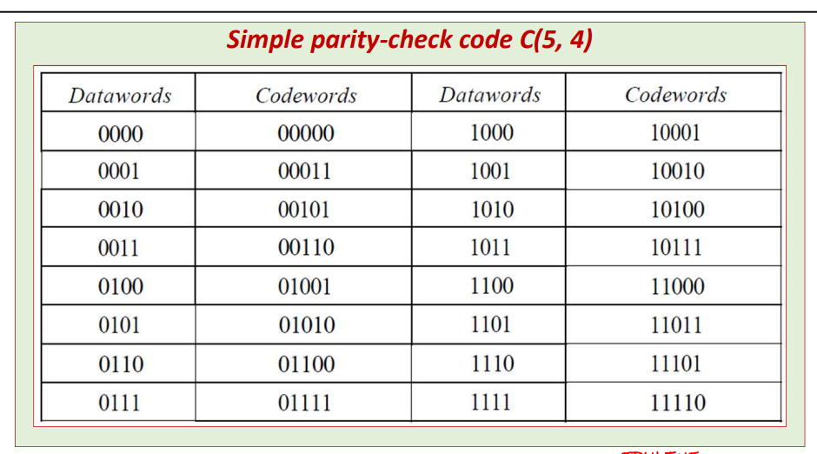

Slide 38
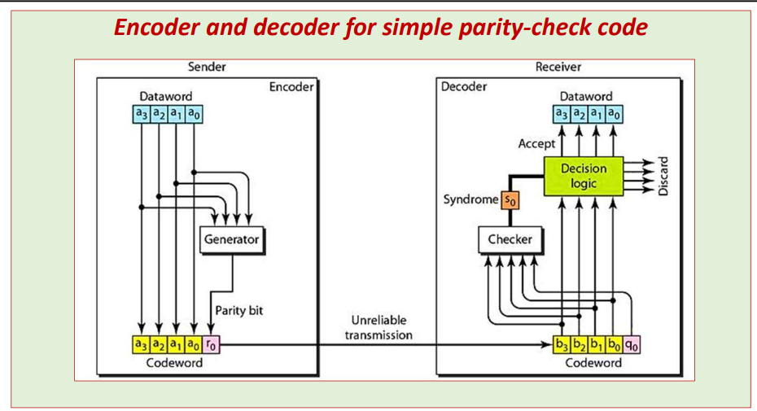

Slide 39
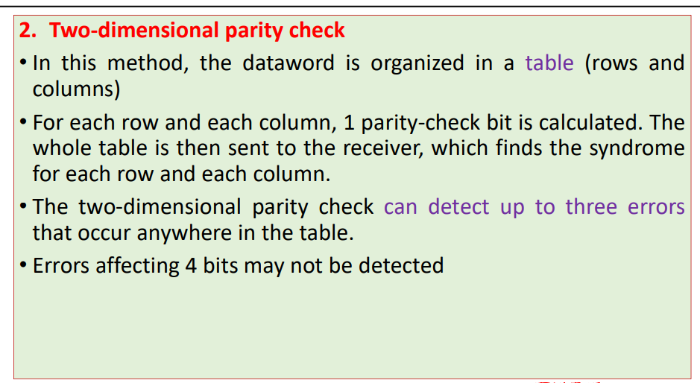

Slide 40
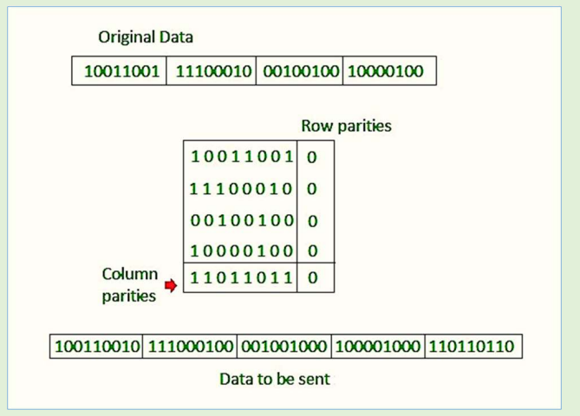

Slide 41
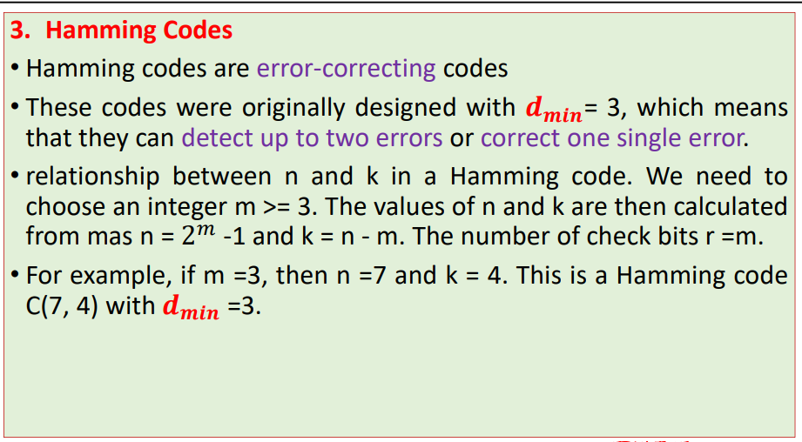

Slide 42
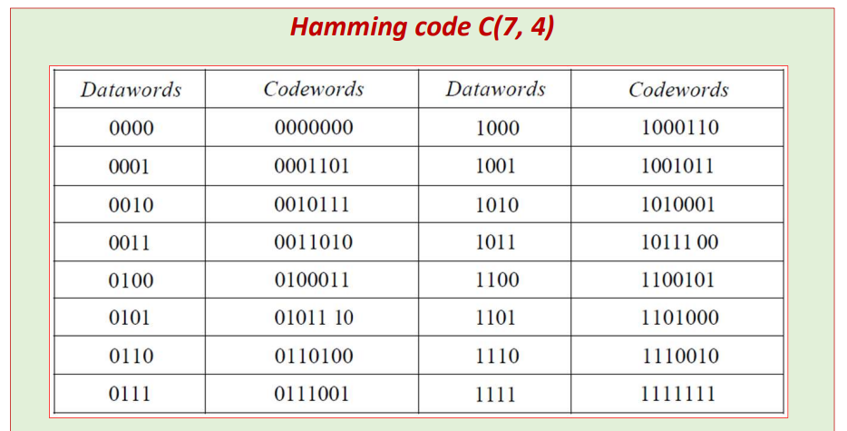

Slide 43
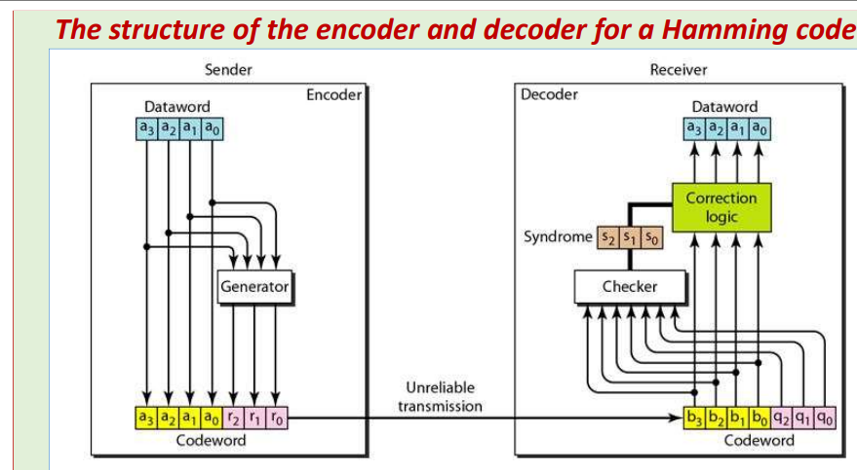

Slide 44
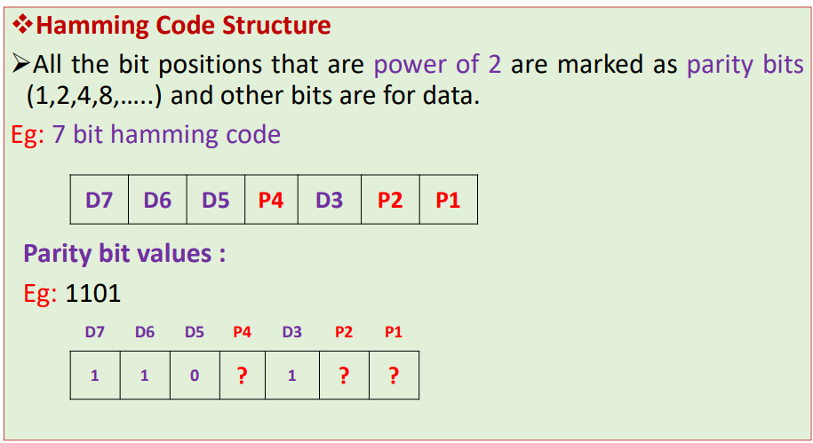

Slide 45
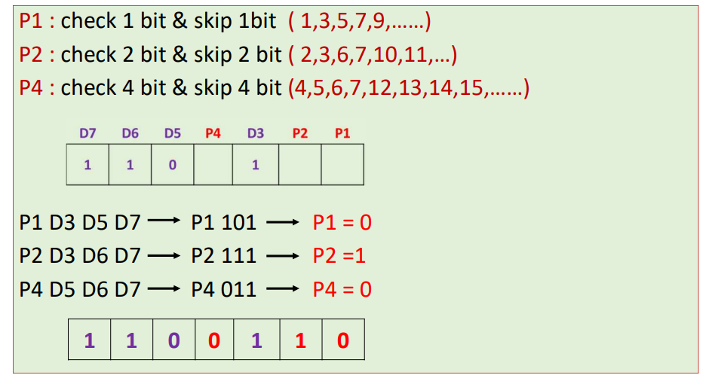

Slide 46
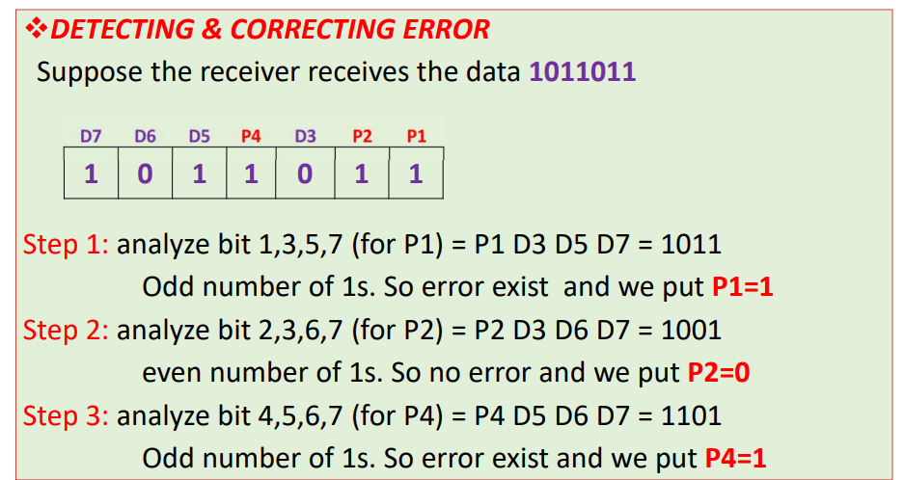

Slide 47
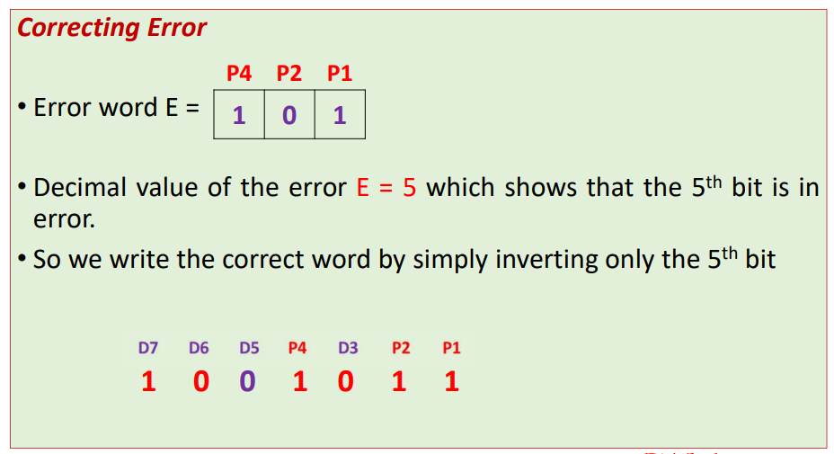

Slide 48
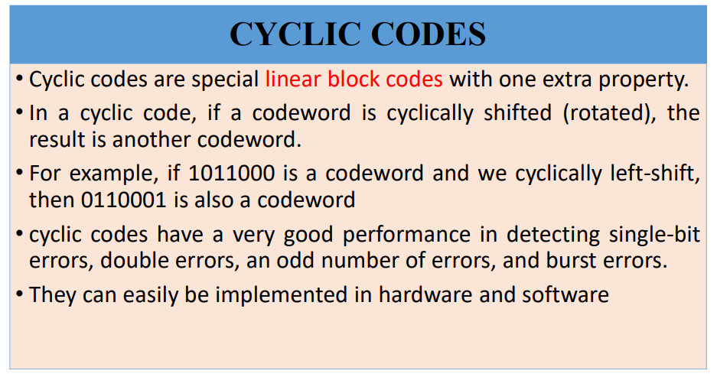

Slide 49
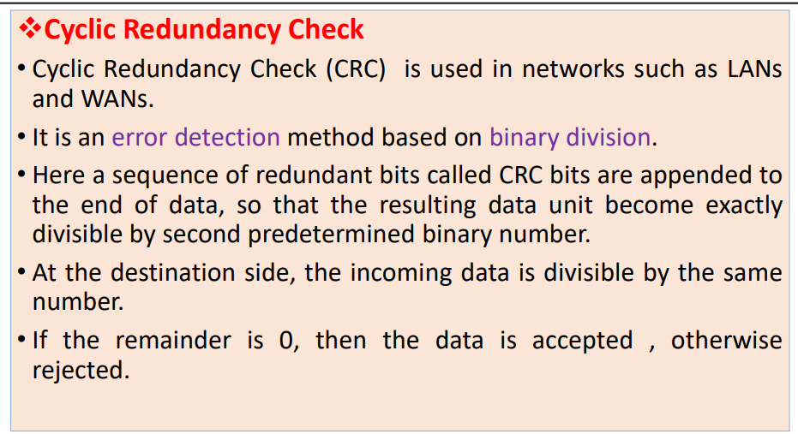

Slide 50
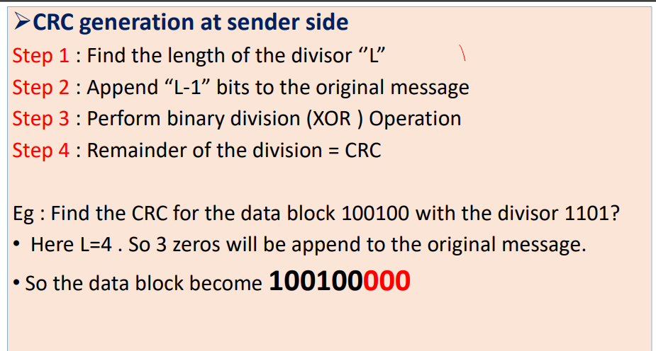

Slide 51
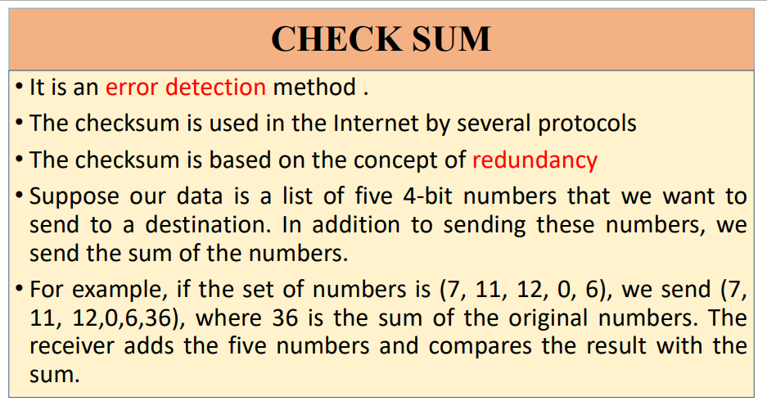

Slide 52
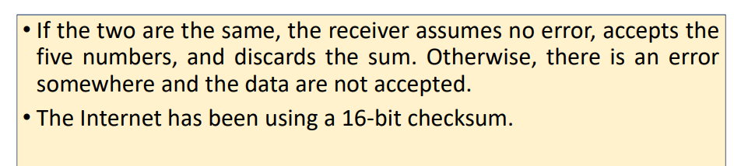

Slide 53
3. Error Correction (FEC)

Slide 54
Forward Error Correction & Hamming Distance
Forward Error Correction (FEC):
Receiver detects and CORRECTS errors without retransmission.
Hamming Distance (d):
Number of bits that differ between two corresponding codewords.
e.g., d(000, 011) = 2
Rules:
• To detect 's' errors: d_min > s
• To correct 't' errors: d_min > 2t
• For single bit correction (t=1): d_min must be 3.

Slide 55
Hamming Code: Logic & Structure
Redundancy Bit (r) Calculation:
Formula: 2^r >= m + r + 1
where m = data bits, r = redundancy bits.
For 7-bit data (ASCII):
• m=7. Trial: 2^4 = 16 >= 7 + 4 + 1. So, r=4.
• Total bits = 11.
Bit Positioning:
• Parity bits occupy power-of-2 positions: 1, 2, 4, 8...
• Data bits fill the rest: 3, 5, 6, 7, 9, 10, 11...

Slide 56
Hamming Code Example
Problem: Encode Data '1001101' using Even Parity.
Placement (11 bits Total):
P1 P2 D1 P4 D2 D3 D4 P8 D5 D6 D7
P1 P2 1 P4 0 0 1 P8 1 0 1
Calculations (Even Parity):
• P1 (Checks 1,3,5,7,9,11): ? 1 0 1 1 1 -> sum=4 (Even) -> P1=0
• P2 (Checks 2,3,6,7,10,11): ? 1 0 1 0 1 -> sum=3 (Odd) -> P2=1
• P4 (Checks 4,5,6,7): ? 0 0 1 -> sum=1 (Odd) -> P4=1
• P8 (Checks 8,9,10,11): ? 1 0 1 -> sum=2 (Even) -> P8=0
Final Codeword: 01110010101

Slide 57
4. Switching Techniques

Slide 58
Switching Networks
A switched network consists of specific connection devices (Nodes) and links.
Purpose:
To allow communication between any two devices without having a dedicated permanent link between every pair.
Taxonomy:
• Circuit Switching
• Packet Switching
• Message Switching

Slide 59
Circuit Switching
Architecture:
• A set of switches connected by physical links.
• A dedicated physical path is reserved for the entire duration.
Three Phases:
1. Setup Phase: Request signal finds path, resources reserved.
2. Data Transfer Phase: Continuous flow, no headers needed.
3. Teardown Phase: A signal releases resources.
Efficiency & Delay:
• Low efficiency (channel idle during silence).
• Low delay (once established).

Slide 60
Switching Techniques
In large networks there might be multiple paths linking sender and receiver. Information may be switched as it travels through various communication channels. There are three typical switching techniques available for digital traffic.
Circuit Switching
Message Switching
Packet Switching

Slide 61
Circuit Switching
Circuit switching is a technique that directly connects the sender and the receiver in an unbroken path.
Telephone switching equipment, for example, establishes a path that connects the caller's telephone to the receiver's telephone by making a physical connection.
With this type of switching technique, once a connection is established, a dedicated path exists between both ends until the connection is terminated.
Routing decisions must be made when the circuit is first established, but there are no decisions made after that time.

Slide 62
Circuit Switching
Circuit switching in a network operates almost the same way as the telephone system works.
A complete end-to-end path must exist before communication can take place.
The computer initiating the data transfer must ask for a connection to the destination.
Once the connection has been initiated and completed to the destination device, the destination device must acknowledge that it is ready and willing to carry on a transfer.

Slide 63
Circuit switching
Advantages:
The communication channel (once established) is dedicated.
Disadvantages:
Possible long wait to establish a connection, (10 seconds,
more on long- distance or international calls.) during which
no data can be transmitted.
More expensive than any other switching techniques,
because a dedicated path is required for each connection.
Inefficient use of the communication channel, because the
channel is not used when the connected systems are not
using it.

Slide 64
Message Switching
With message switching there is no need to establish a dedicated path between two stations.
When a station sends a message, the destination address is appended to the message.
The message is then transmitted through the network, in its entirety, from node to node.
Each node receives the entire message, stores it in its entirety on disk, and then transmits the message to the next node.
This type of network is called a store-and-forward network.

Slide 65
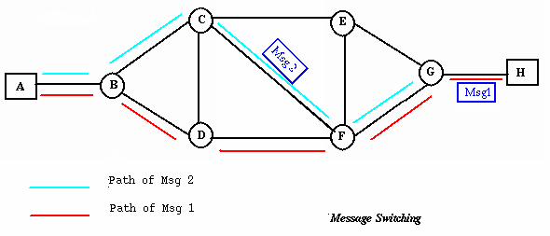
Message Switching
A message-switching node is typically a general-purpose computer. The device needs sufficient secondary-storage capacity to store the incoming messages, which could be long. A time delay is introduced using this type of scheme due to store- and-forward time, plus the time required to find the next node in the transmission path.

Slide 66
Message Switching
Advantages:
Channel efficiency can be greater compared to circuit-
switched systems, because more devices are sharing the
channel.
Traffic congestion can be reduced, because messages may be
temporarily stored in route.
Message priorities can be established due to store-and-forward
technique.
Message broadcasting can be achieved with the use of
broadcast address appended in the message.

Slide 67
Message Switching
Disadvantages
Message switching is not compatible with interactive
applications.
Store-and-forward devices are expensive, because they
must have large disks to hold potentially long messages.

Slide 68
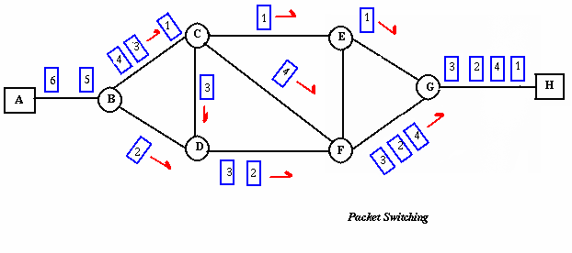
Packet Switching
Packet switching can be seen as a solution that tries to combine the
advantages of message and circuit switching and to minimize the
disadvantages of both.
There are two methods of packet switching: Datagram
and virtual circuit.

Slide 69
Packet Switching
In both packet switching methods, a message is broken into
small parts, called packets.
Each packet is tagged with appropriate source and destination
addresses.
Since packets have a strictly defined maximum length, they
can be stored in main memory instead of disk, therefore access
delay and cost are minimized.
Also the transmission speeds, between nodes, are optimized.
With current technology, packets are generally accepted onto
the network on a first-come, first-served basis. If the network
becomes overloaded, packets are delayed or discarded
(``dropped'').

Slide 70
Packet size
The size of the packet can vary from 180 bits, the size for the Datakit® virtual circuit switch designed by Bell Labs for communications and business applications; to 1,024 or 2,048 bits for the 1PSS® switch, also designed by Bell Labs for public data networking; to 53 bytes for ATM switching, such as Lucent Technologies' packet switches.

Slide 71
Packet switching
In packet switching, the analog signal from your phone is converted into a digital data stream. That series of digital bits is then divided into relatively tiny clusters of bits, called packets. Each packet has at its beginning the digital address -- a long number -- to which it is being sent. The system blasts out all those tiny packets, as fast as it can, and they travel across the nation's digital backbone systems to their destination: the telephone, or rather the telephone system, of the person you're calling.
They do not necessarily travel together; they do not travel sequentially. They don't even all travel via the same route. But eventually they arrive at the right point -- that digital address added to the front of each string of digital data -- and at their destination are reassembled into the correct order, then converted to analog form, so your friend can understand what you're saying.

Slide 72
Packet Switching: Datagram
Datagram packet switching is similar to message switching in
that each packet is a self-contained unit with complete
addressing information attached.
This fact allows packets to take a variety of possible paths
through the network.
So the packets, each with the same destination address, do not
follow the same route, and they may arrive out of sequence at
the exit point node (or the destination).
Reordering is done at the destination point based on the
sequence number of the packets.
It is possible for a packet to be destroyed if one of the nodes on
its way is crashed momentarily. Thus all its queued packets may
be lost.

Slide 73
Packet Switching:Virtual Circuit
In the virtual circuit approach, a preplanned route is established
before any data packets are sent.
A logical connection is established when
a sender send a "call request packet" to the receiver and
the receiver send back an acknowledge packet "call accepted
packet" to the sender if the receiver agrees on conversational
parameters.
The conversational parameters can be maximum packet sizes,
path to be taken, and other variables necessary to establish and
maintain the conversation.
Virtual circuits imply acknowledgements, flow control, and error
control, so virtual circuits are reliable.
That is, they have the capability to inform upper-protocol layers
if a transmission problem occurs.

Slide 74
Packet Switching:Virtual Circuit
In virtual circuit, the route between stations does not mean that
this is a dedicated path, as in circuit switching.
A packet is still buffered at each node and queued for output over
a line.
The difference between virtual circuit and datagram approaches:
With virtual circuit, the node does not need to make a routing
decision for each packet.
It is made only once for all packets using that virtual circuit.

Slide 75
Packet Switching: Virtual Circuit
VC's offer guarantees that
the packets sent arrive in the order sent
with no duplicates or omissions
with no errors (with high probability)
regardless of how they are implemented internally.

Slide 76
Advantages of packet switching
Advantages:
Packet switching is cost effective, because switching
devices do not need massive amount of secondary
storage.
Packet switching offers improved delay characteristics,
because there are no long messages in the queue
(maximum packet size is fixed).
Packet can be rerouted if there is any problem, such as,
busy or disabled links.
The advantage of packet switching is that many
network users can share the same channel at the same
time. Packet switching can maximize link efficiency by
making optimal use of link bandwidth.

Slide 77
Disadvantages of packet switching
Disadvantages:
Protocols for packet switching are typically more complex.
It can add some initial costs in implementation.
If packet is lost, sender needs to retransmit the data.
Another disadvantage is that packet-switched systems still
can’t deliver the same quality as dedicated circuits in
applications requiring very little delay - like voice
conversations or moving images.

Slide 78
Packet Switching
Concept:
Message is broken into small chunks called 'Packets'.
Each packet contains header information (Source/Dest IP, Sequence No).
Types:
1. Datagram Network:
- Each packet treated independently.
- Different routes possible (Out of order arrival).
2. Virtual Circuit Network:
- Setup phase establishes a 'logical' path.
- All packets follow same path but resources are not exclusively reserved.

Slide 79
Message Switching
Store-and-Forward Mechanism:
• Entire message is received at a node, stored in memory, inspected for errors, and then forwarded.
Characteristics:
• No physical path establishment.
• Efficient for bursty traffic.
• High Latency (Delay at every hop).
• Obsolescent for general networking, but concept survives in Email/SMS.

Slide 80
Conclusion & Summary
Module 5 covers the reliability mechanism of Data Comm.
Detection: CRC is the industry standard (Polynomial Math).
Correction: Hamming Code enables self-repair of data bits.
Switching: Evolution from Circuit (Phone) to Packet (Internet).
Critical for understanding Transport and Network layers.

